Slide 1
CS3186
Identifying
Non-regular Languages
Section 4.3

Slide 2
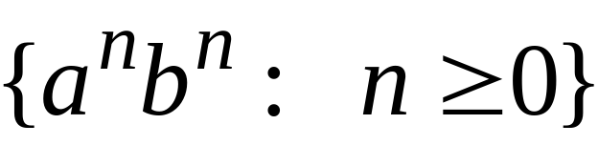
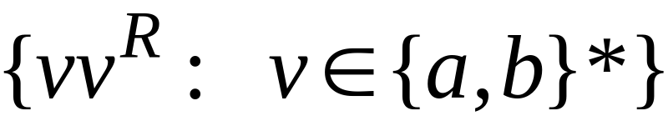


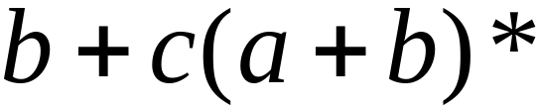

Non-regular languages
Regular languages

Slide 3
Pigeonhole Principle
Pigeonhole Principle:
Consider a flock of pigeons nestled in a set of n pigeonholes. If there are n pigeons, then it is possible for all of the pigeons to rest happily in separate pigeonholes.
However, if at least one more pigeon arrives, making a total of more than n pigeons, then at least one of the pigeonholes, inevitably, will end up with more than one pigeon.

Slide 4
Pigeonhole Principle
Pigeonhole Principle:
The idea is so seemingly trivial, but it turns out to be important enough that it has a name.
Mathematicians have used this principle to derive many important results.
Observations:
Finite automata with limited memory (finite states) cannot accept all infinite languages.
There exists languages that are not regular!

Slide 5

How can we prove that a language
is not regular?
Prove that there is no DFA that accepts
Wrong. This is not possible.
Solution: the Pumping Lemma !!!

Slide 6
The Pumping Lemma

Slide 7


Take an infinite regular language
There exists a DFA that accepts
states

Slide 8


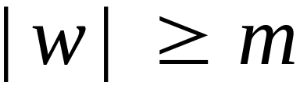

Take string with
If string has length
(number
of states
of DFA)
Then, a state is repeated in the walk
......
......
walk

Slide 9

Let be the first state repeated in the
walk of
......
......
walk

Slide 10




Write
......
......

Slide 11

Observations:
(1) length of since scanning m symbols would imply a repetition of any one state.
(2) |y| ≥ 1 since at least one symbol has been scanned
......
......

Slide 12

Observation:
The string
is accepted
......
......

Slide 13


Observation:
The strings and
Are also accepted
......
......

Slide 14

Observation:
The string
is also accepted
......
......

Slide 15
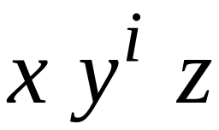

In General:
The strings
are accepted
......
......

Slide 16
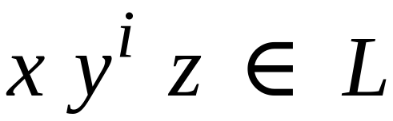
In General:
Language accepted by the DFA
......
......

Slide 17
This descries the pumping lemma
The Pumping Lemma !!!

Slide 18
Applications of the Pumping Lemma
(Proof by contradiction)

Slide 19
Application of Pumping Lemma
Given L is an infinite language. Assume L be a regular language L.
There exists an integer m (# of states of DFA)
There exists a string w in L, |w| ≥ m. Choose a string w. (The length of the |w| is known as pumping length).
Write w=xyz such that |xy| ≤ m and |y| ≥ 1
For all i ≥ 0: xy^{i}z ∈ L
  i.e., if a string y is ‘pumped’ (inserted any number of times), the resultant string still remains in L.
  Find a contradiction. i.e., find any one string for some value of “i” which is not in L.
  Our assumption that L is regular is not true. Hence, L is not regular.

Slide 20
Show that a language is not regular
(Game play)
Given L is an infinite language.
Computer: Claims that L is regular; Picks m;
You: Pick string w in L, such that |w| ≥ m.
Computer: Write w=xyz such that |xy| ≤ m and |y| ≥ 1
  You: Find a contradiction. i.e., find any one string, xy^{i}z, for some value of “i” which is not in L.
  You win and can claim that L is not regular.

Slide 21
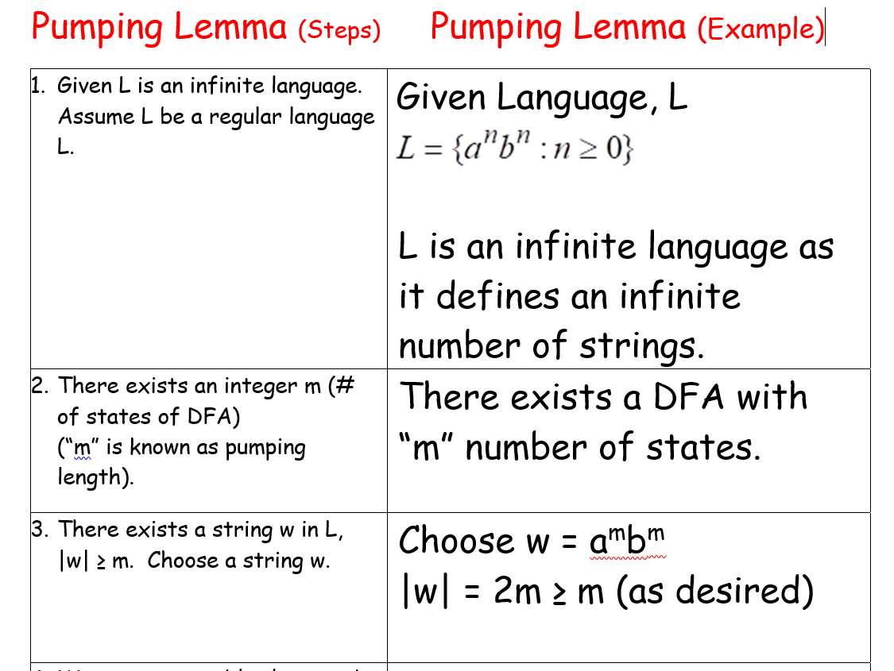
Pumping Lemma – Example-1

Slide 22
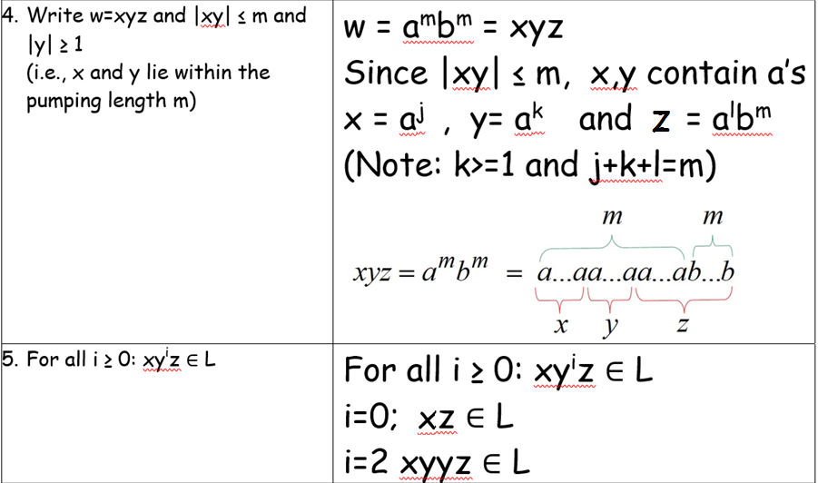

Slide 23
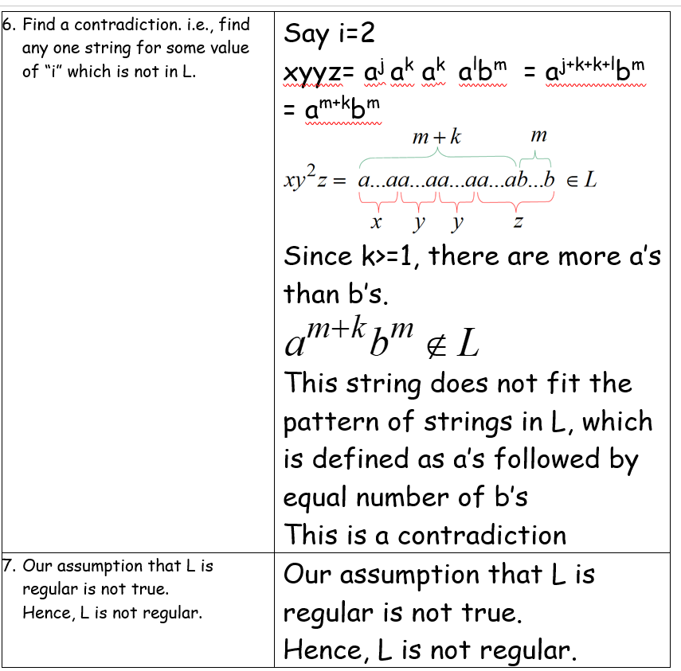

Slide 24
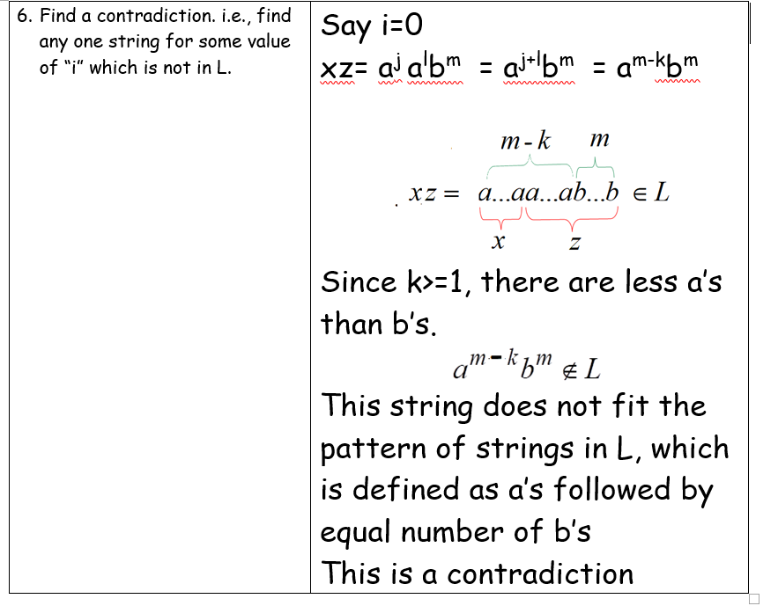
In the above example, we can show the contradiction for any value of “i” . For example, Step 6 can also be

Slide 25
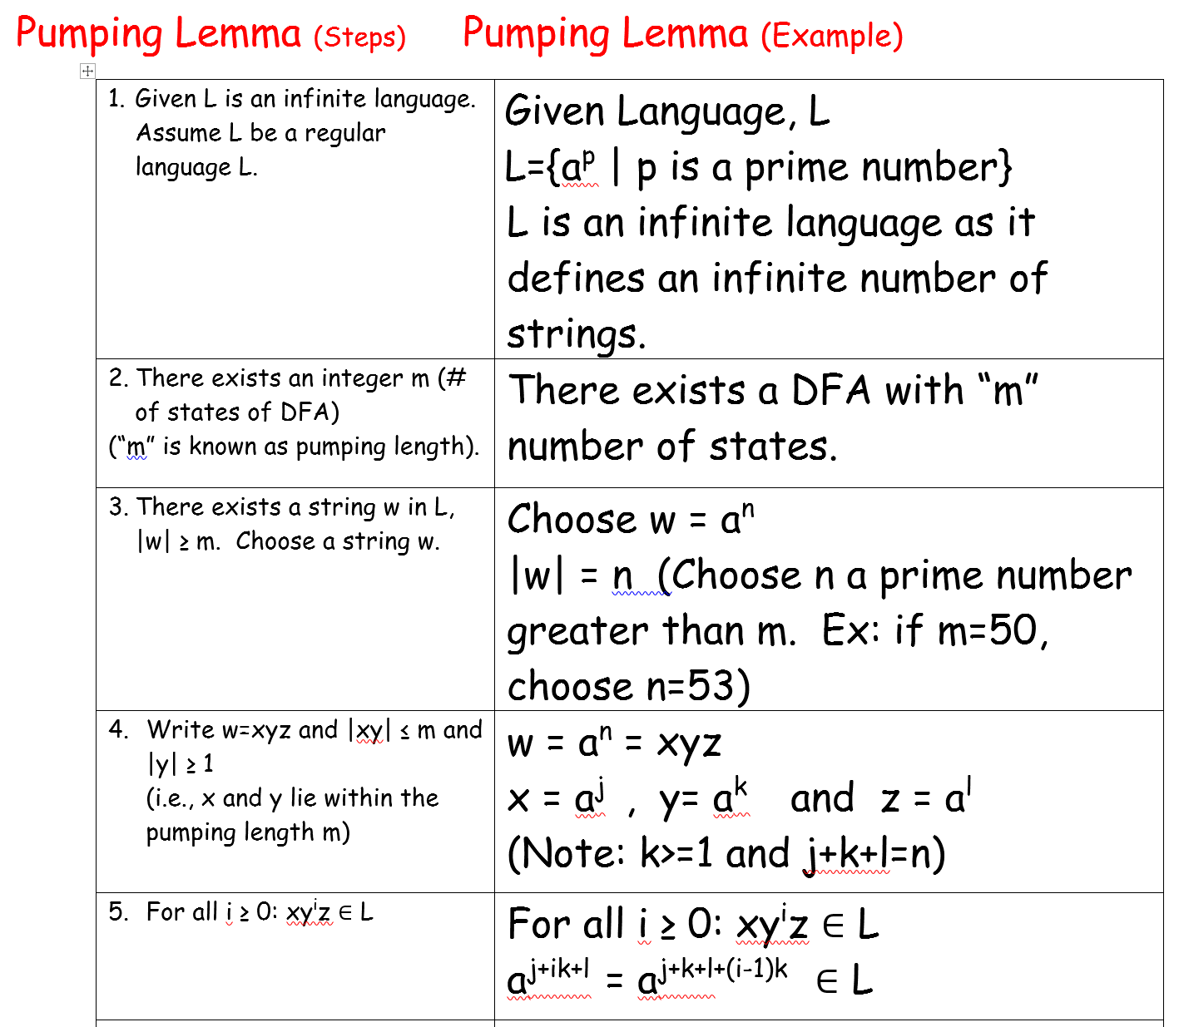
Pumping Lemma – Example-2

Slide 26
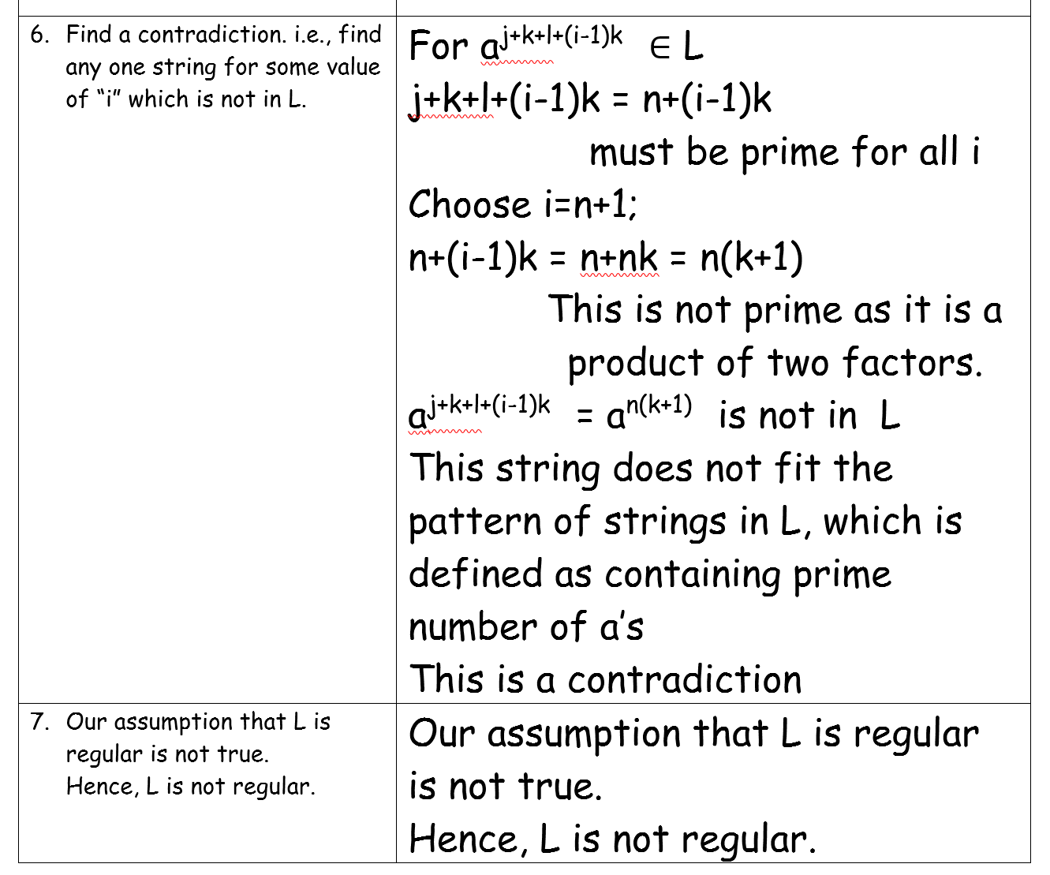

Slide 27
Summary
Pumping lemma is not used for proving whether a language is regular. It is rather used for proving if the language is not regular.
Do not use pumping lemma on languages that are regular as one can draw incorrect conclusions. The following languages are all regular and can construct a DFA with finite number of states.
a*b*
a*b¹⁰⁰
a^{m}b^{n} | m>0; n>1
Chapter 2-Chapter 4 completes discussion on Regular Languages which is the lowest level in the Language Hierarchy (Chomsky Hierarchy of formal languages.)

Slide 28
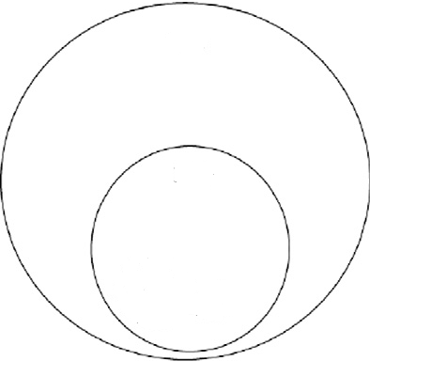

Language Hierarchy
Non-regular languages
Regular languages

Slide 29


(I) Use Pumping Lemma to show that L is not regular.
(i) L ={a^{n}b^{n} | n>=0}
(ii) L ={a^{n}b^{2n} | n>=0}
(iii) L ={a^{n}ba^{3n} | n>=0}
(iv) L ={a^{n}b²a^{n} | n>=0}
(v) L={ww | w is any sting}
(VI) L= {a^{n}b^{n} | n is a square}
(vii) L={a | n >0}}
(ix) L ={a^{n}b^{m}c^{n} | n,m>=0}
(X) L = { w | w has an equal number of a’s and b’s}
Homework 4.3

